Slide 1
The target (giz projections)
 | 2015 | 2020 | 2025 | 2030 | 2035 | 2040 | 2045 | 2050
Passenger car [PC] stock | 532406 | 745304 | 989915 | 1297828 | 1668898 | 2101272 | 2592984 | 3142422
Inhabitants [in 1000] | 46050 | 53115 | 60180 | 67245 | 74310 | 81375 | 88440 | 95505
Motorisation rate [PC/1000 inhabitants] | 11.56148 | 14.03189 | 16.44924 | 19.29999 | 22.45859 | 25.82208 | 29.31913 | 32.90322

Slide 2
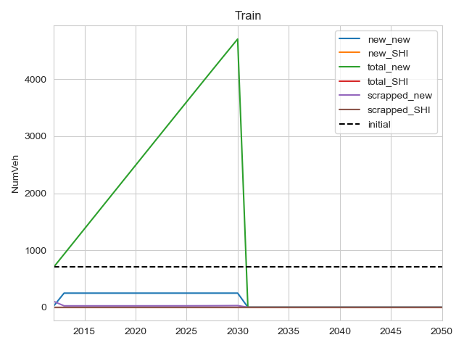
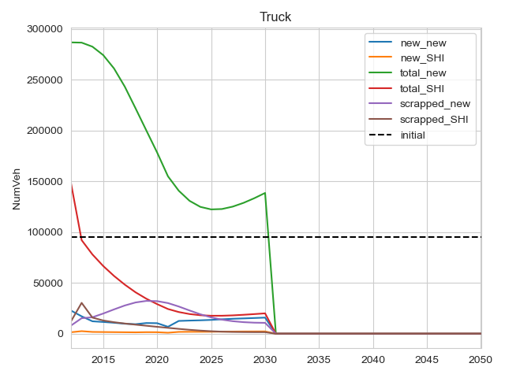
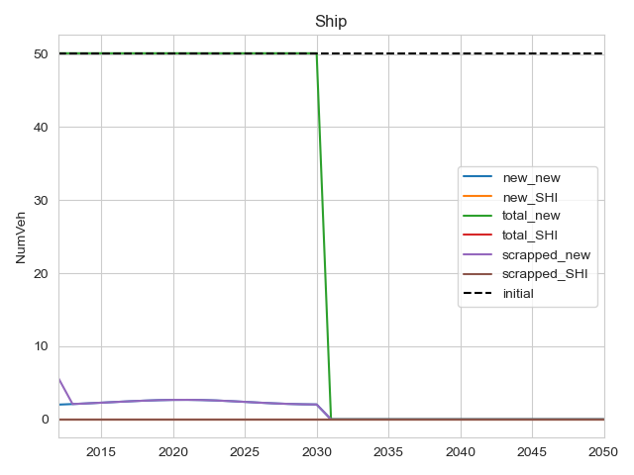
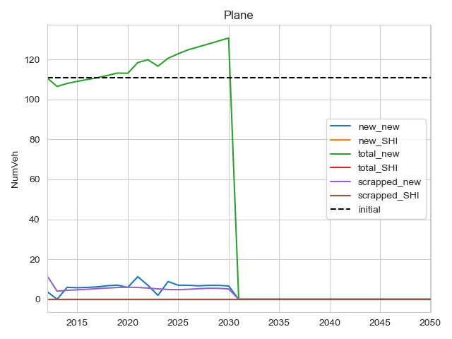
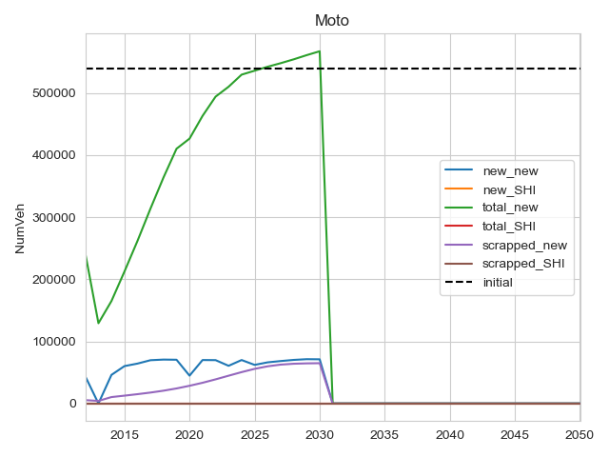
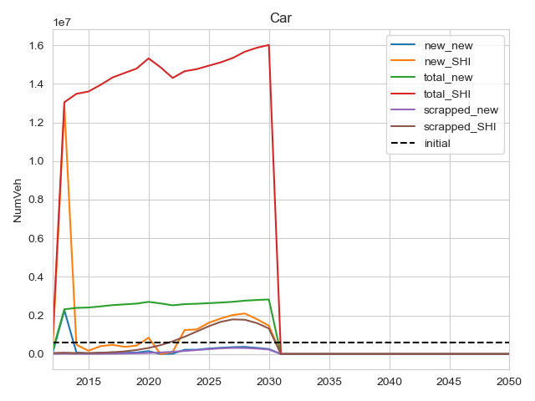
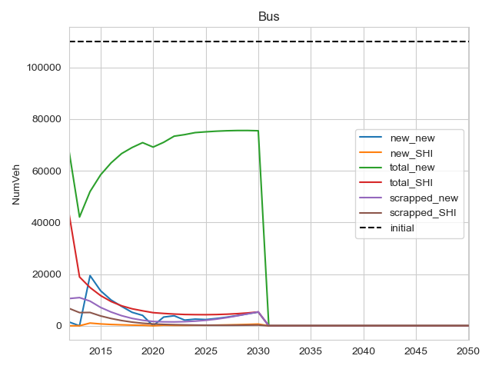
First attempt
Travel_demand is old (the values on RHS don’t match)
The max car own values haven’t been changed

Slide 3
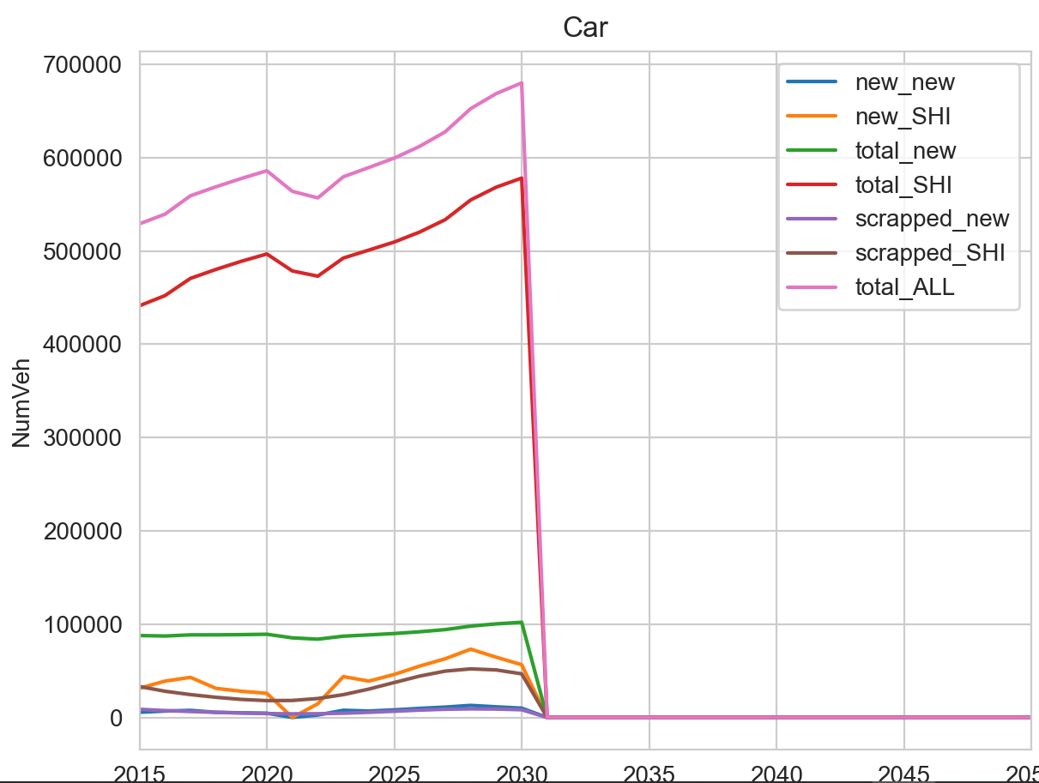
attempt3
The car own values have been changed – current ones div 30; max ones div 10
The travel_demand now matches up

Slide 4
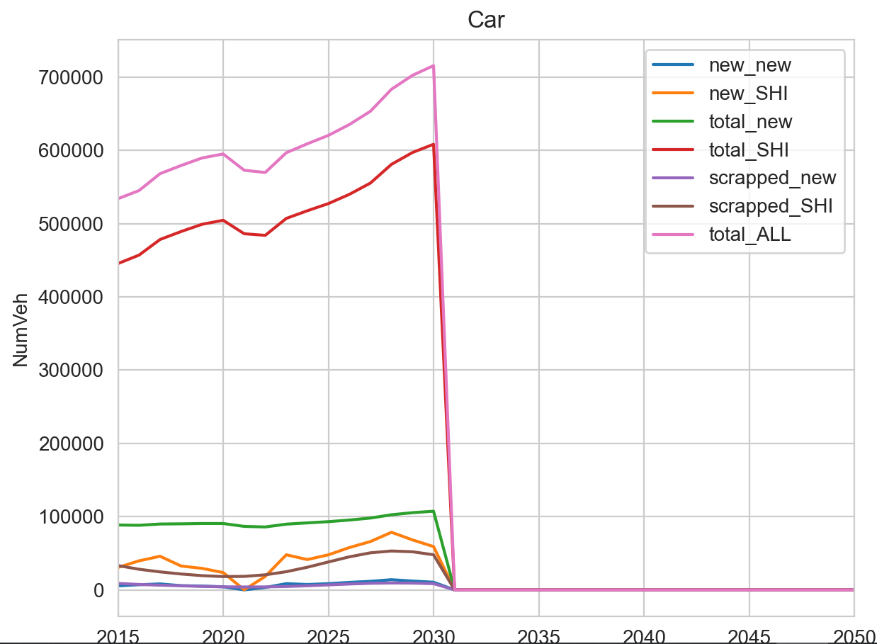

attempt4
Just turned maxhhcarown values down to half the UK values. Left the current ones the same (30th). What happens..?
Actually the current levels should be ~10th vs uk levels.

Slide 5
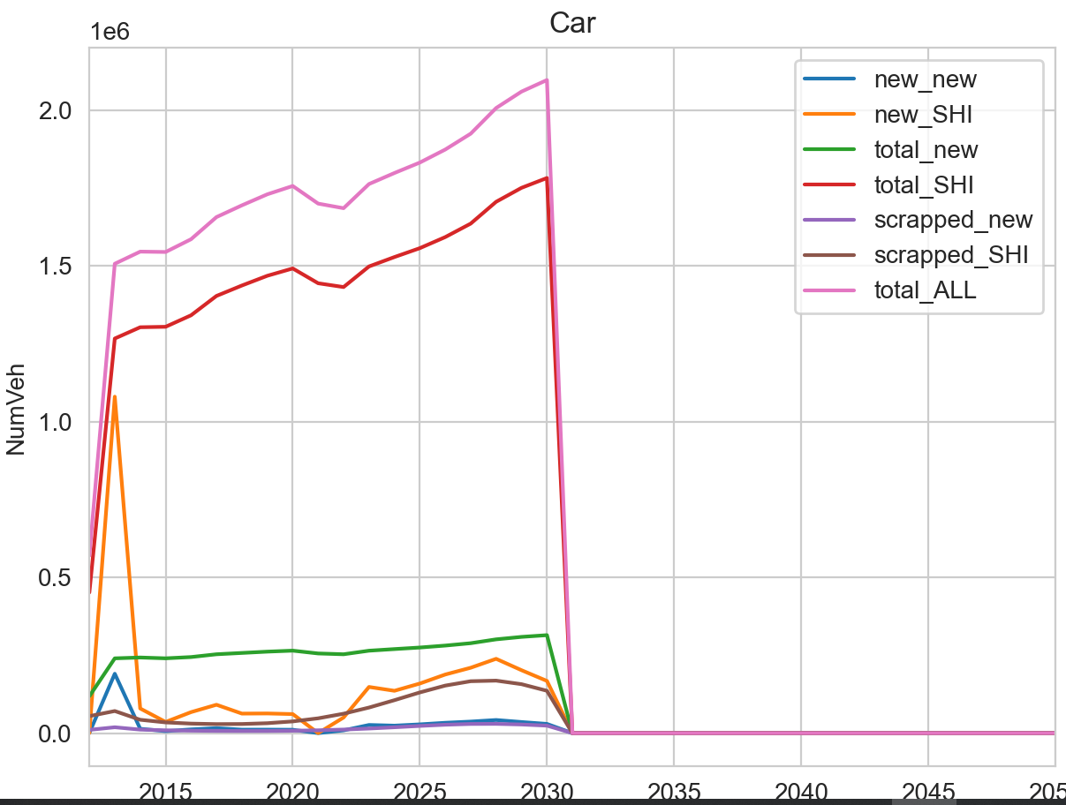
attempt5
Set the current levels at 10th of the Uk levels
Didn’t work now starts off way higher than the existing stock.
Next try a 20th

Slide 6
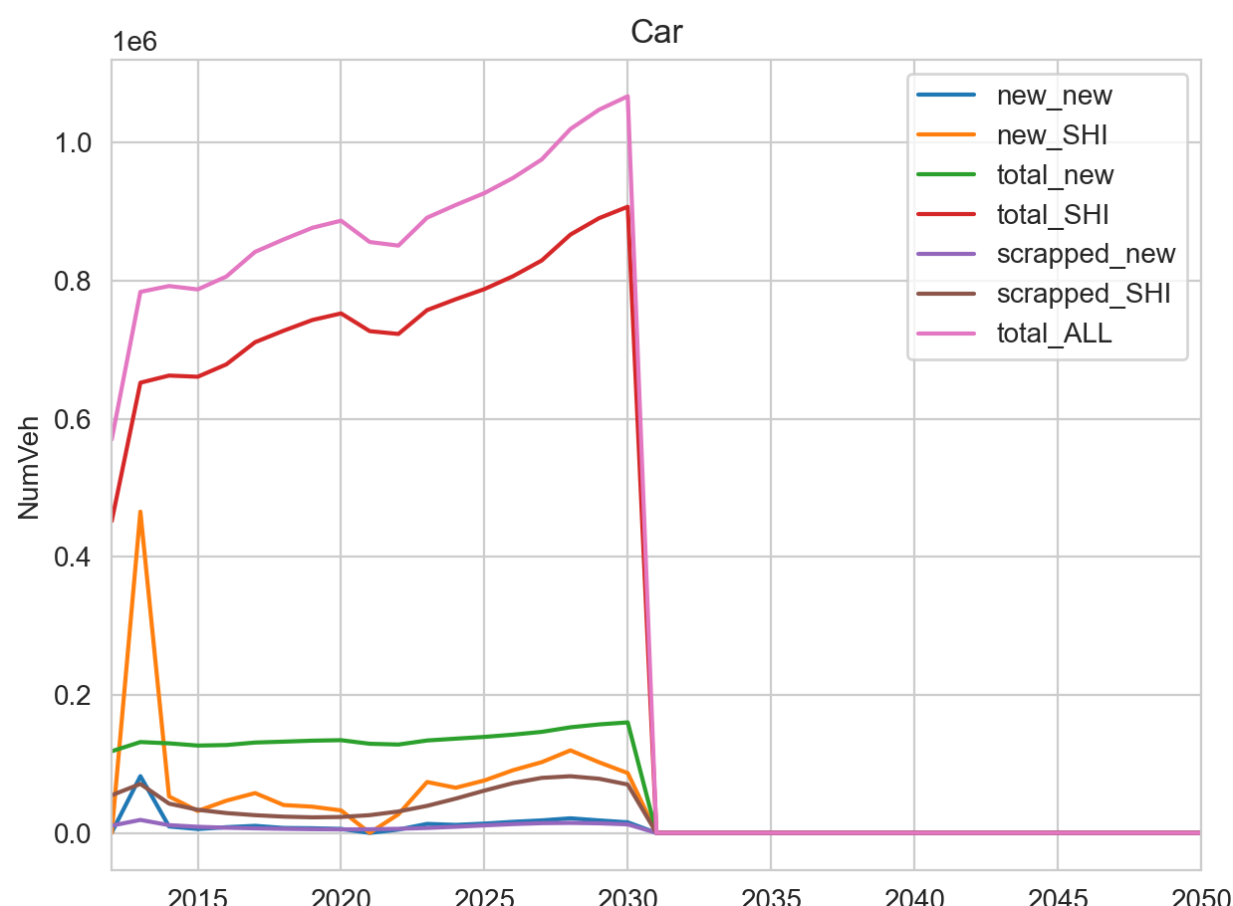
attempt6
That’s 20th for the current levels. There’s a massive spike in

Slide 7
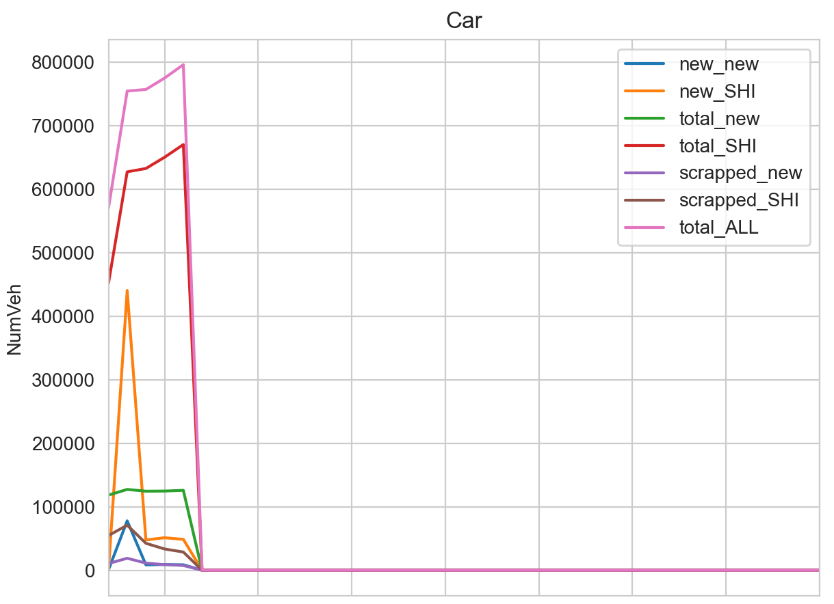
This time played with the propensity factors – down to ZERO for the first three years
Still massive spike in the fucking fucks

Slide 8
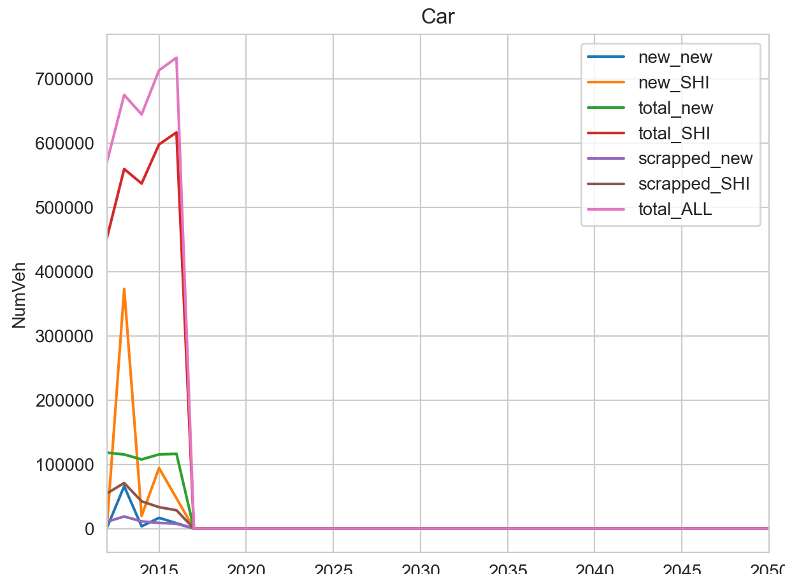
This time turned it down to minus 10 for the first three years
Still doesn’t do what we need
The good news is that we know that we don’t have to run those cunting macros first, just go straight inty TDM

Slide 9
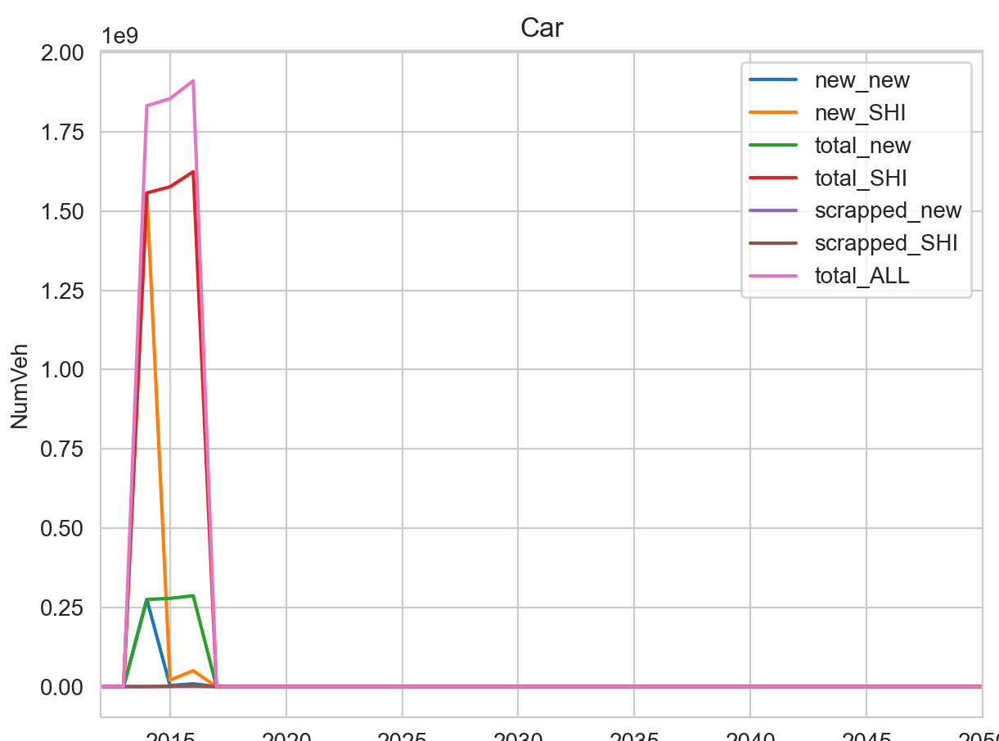
Just one last try on these parameters. Changed them to -10000 on both.
Officially what the piss
Changed it back

Slide 10
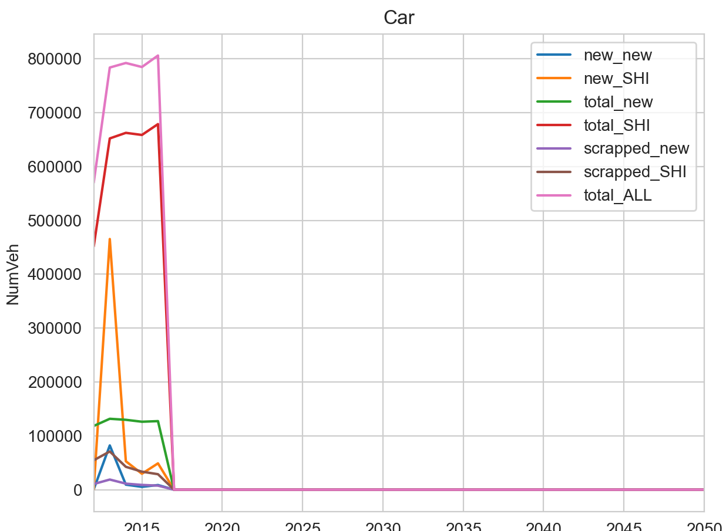
Changed all the newveh for the base year to zero to try and stop the spike. But the spike is on 2013 so not affected.
Next plan – scale the base year stocks from 2015 to 2012 using the giz data. Input.

Slide 11
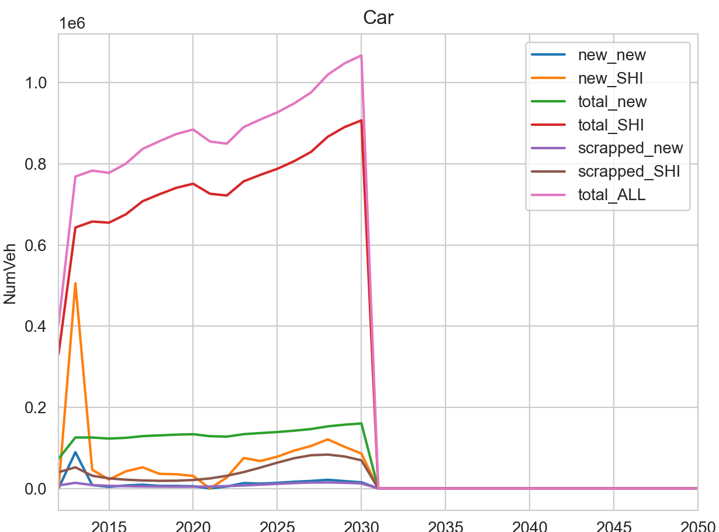
With lower initial stock values
It climbs to the same level. The new cars in 2013 is still this spike
Try reducing current hh own levels again

Slide 12
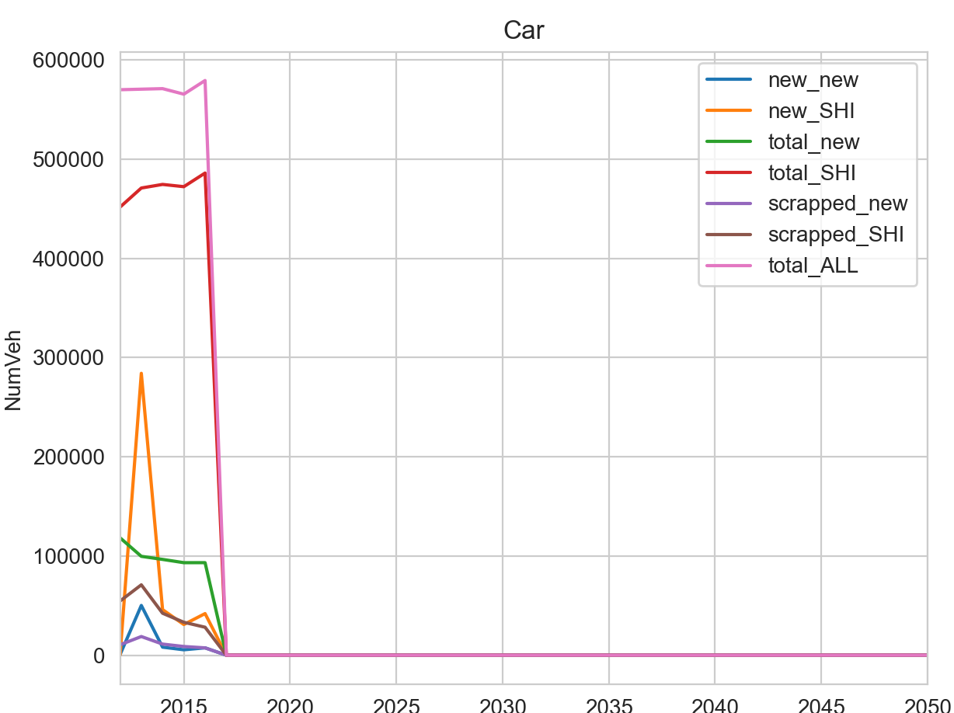
attempt12
Finally what we want before 2015. run it to 2030

Slide 13
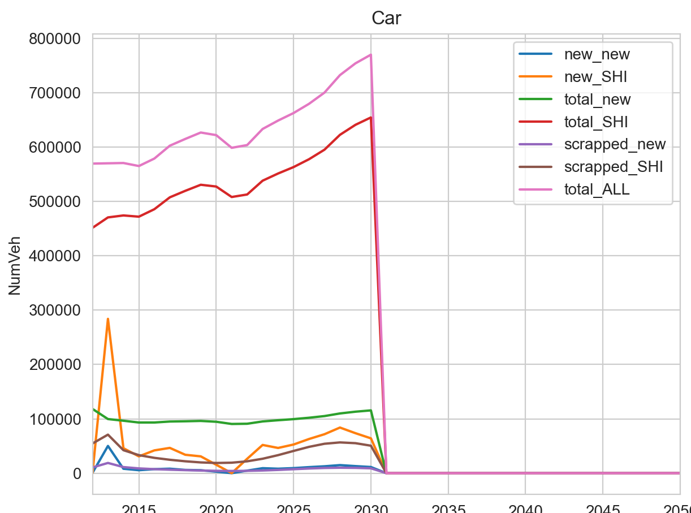
Attempt12 to 2030
Much better but need a steeper slope.
Try increasing the max.

Slide 14
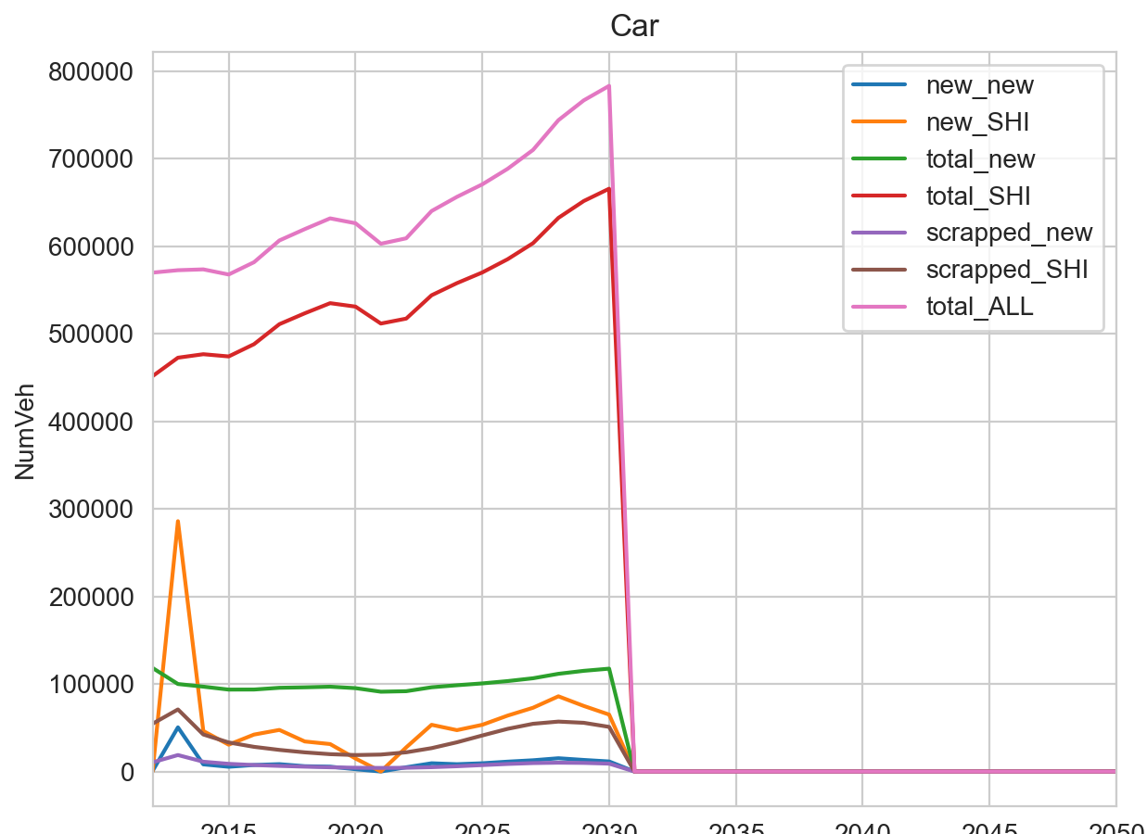
Attempt13
Increased the maxcarown by a factor 2
Very little difference in the steepness.
What about the diff between 2015 and 2017?

Slide 15
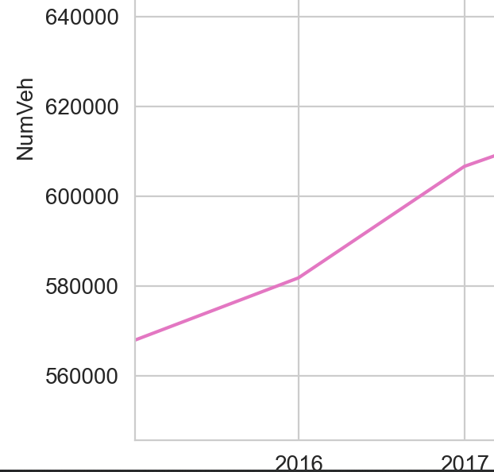
It’s actually pretty good
So it just disagrees with the future projection( GIZ)
One reason is that the population projections differ. The ones in there from statista say 62m pop by 2030. giz say 67m pop by 2030.
Have changed to higher giz figure to see what happens
 | Number of vehicles
Vehicle category | 2015 | 2017
Passenger cars (PC) | 532,406 | 626,896

Slide 16

Now with giz population forecasts. It’s a bit steeper.

Slide 17
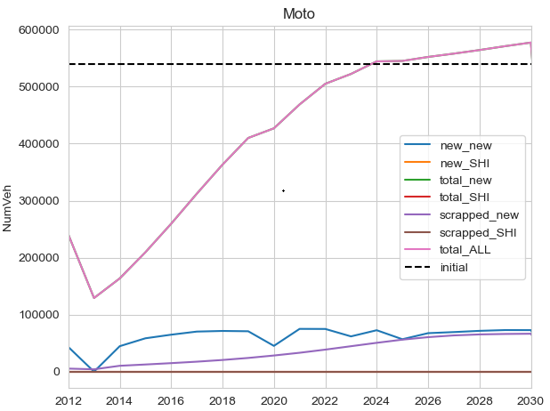
Car is fine certainly as a test run call it a day but what about motoooo
To try this I’m going to double the PKM for motos in the base year.
Changed it from 7 to 15. (BPKM)

Slide 18
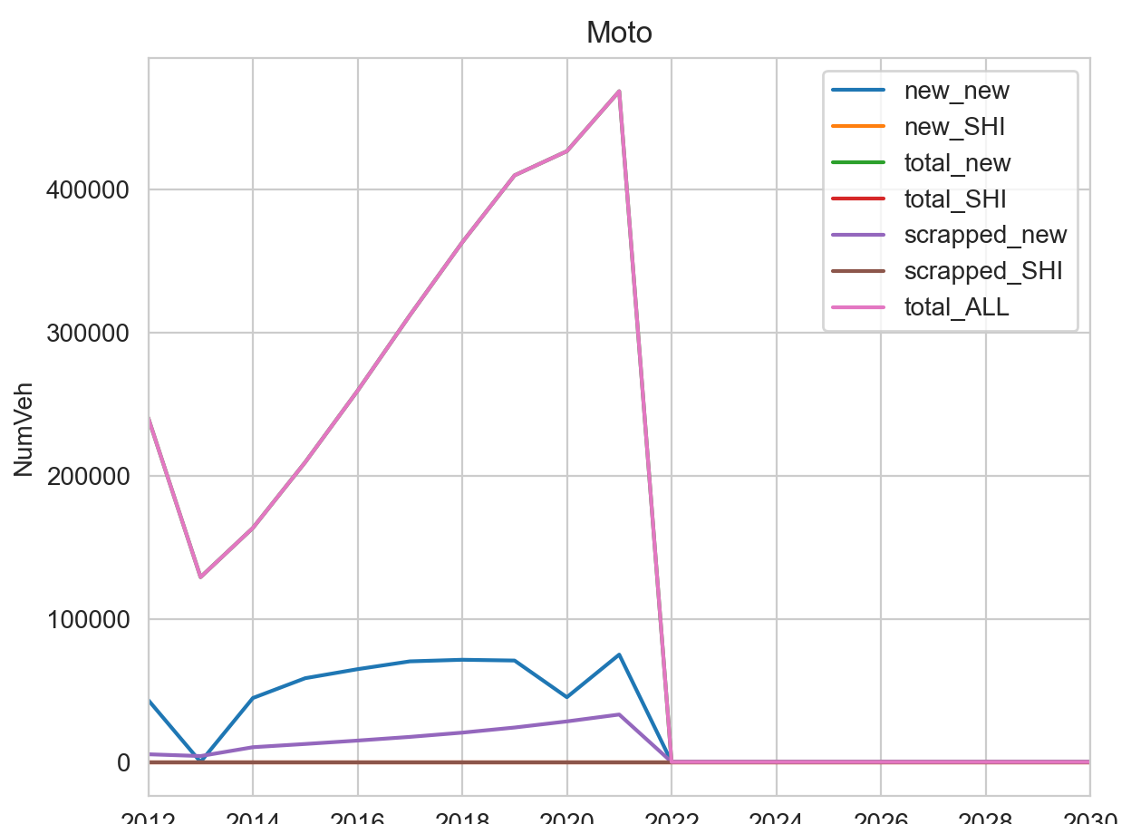
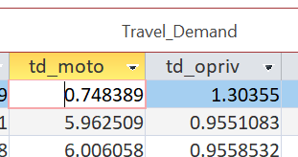
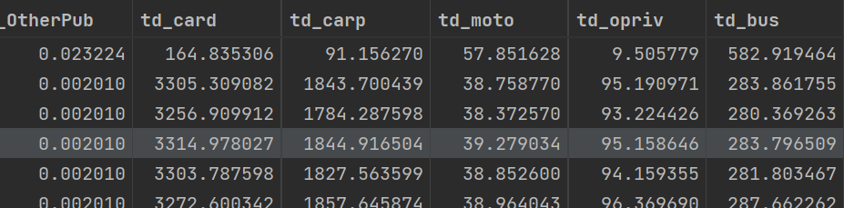
Doesnae fuckin work
Look at the code?
Could be that, but it goes in as:

Slide 19
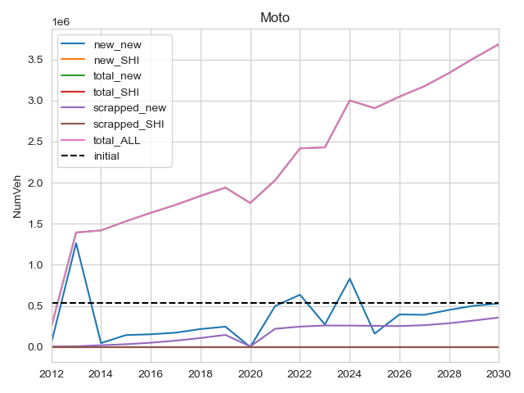

Starts with correct data
Ran it again and you now get much bigger growth but still weirdly not equal to the initial count on 2012

